Slide 1
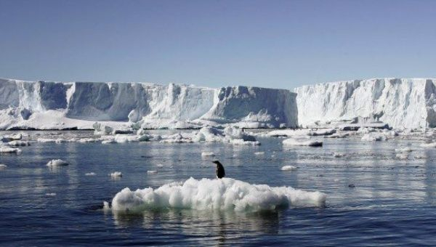
ANTARTICA AND CLIMATE CHANGE
It’s real
It’s us
It’s bad
But there’s hope

Slide 2
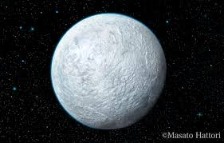
Snowball Earth (700 million years ago)
CO₂
CO₂
CO₂

Slide 3
The isolation of Antarctica: contrast to the Arctic

Slide 4
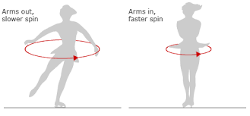
How do you get heat to the poles?
North Pole
COLD
continents
westerlies
HOT
Equator
westerlies
VERY
COLD
South Pole

Slide 5
The isolation of Antarctica: contrast to the Arctic
South polar view
North polar view

Slide 6
Antarctica in the Eocene period (65-35 million years ago)
CO₂ was about twice what it is today, Antarctica was connected to South America
Then the Drake passage opened 35 million years ago, isolating Antarctica,
and CO₂ levels dropped
Antarctica became glaciated in less than a million years

Slide 7
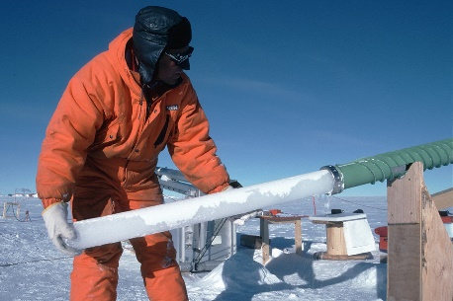
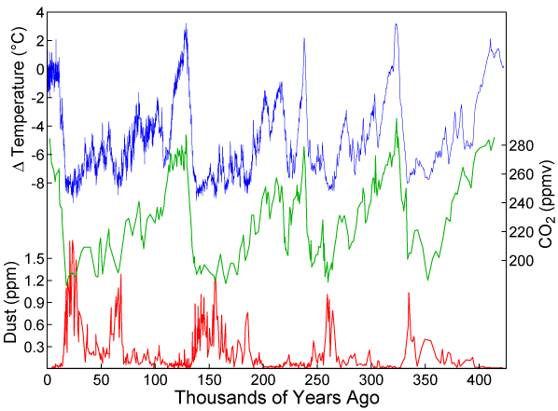
Temperature and CO₂ records in Antarctic ice cores tell the story of more recent climate change
glacial
glacial
glacial
glacial
Vostok ice core (East Antarctica)

Slide 8
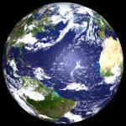
EQUILIBRIUM CLIMATE OF THE EARTH: BALANCE BETWEEN SOLAR AND TERRESTRIAL RADIATION
SOLAR
RADIATION
(visible)
30% reflected by clouds, ice…
TERRESTRIAL
RADIATION
(infrared)

Slide 9
WARMING OF EARTH’S SURFACE BY GREENHOUSE GASES
SOLAR
RADIATION
(visible)
Greenhouse
layer
30% reflected by
clouds, ice…
TERRESTRIAL
RADIATION
(infrared)
Greenhouse gases in
atmosphere absorb
infrared radiation, re-emit
It both upward and downward
Water and CO₂ are the two most important greenhouse gases

Slide 10
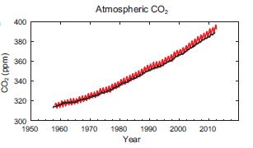
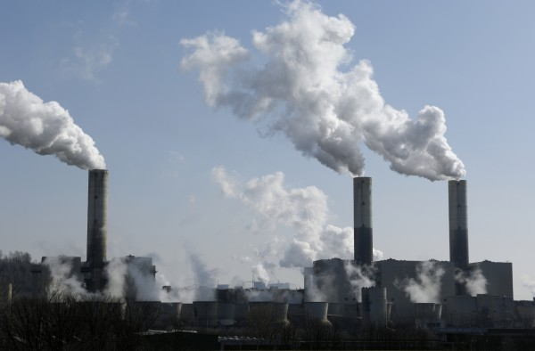
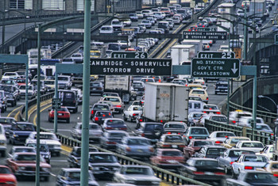
CO₂ increase because of fossil fuels
2017: 405 ppm
Surface observations since 1958 Mauna Loa, Hawaii
South Pole
10 billion tons of carbon
per year (2017)
Ice core records for past 1,000 years

Slide 11
Global surface temperature trend
2020-2022

Slide 12
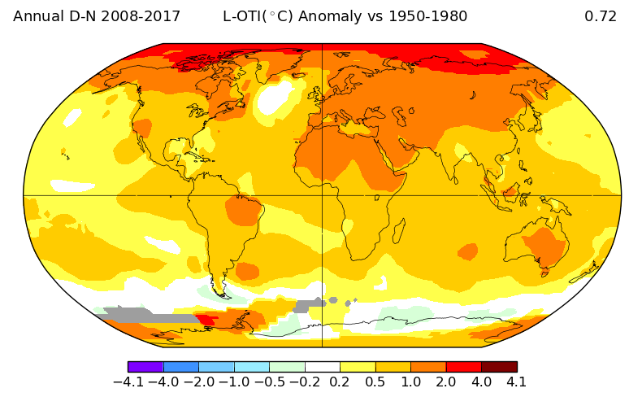
Warming patterns over the past fifty years
Largest warming in the Arctic
Antarctica is complicated
NASA/GISTEMP

Slide 13
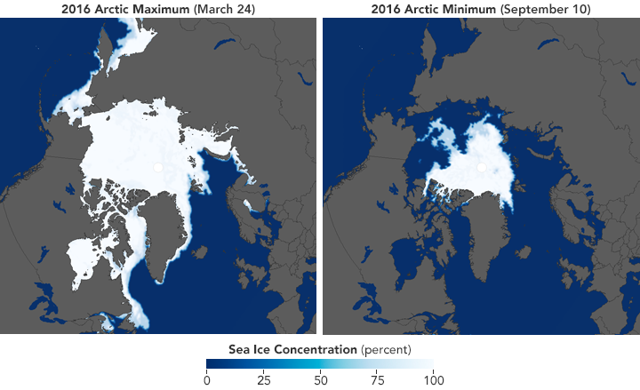
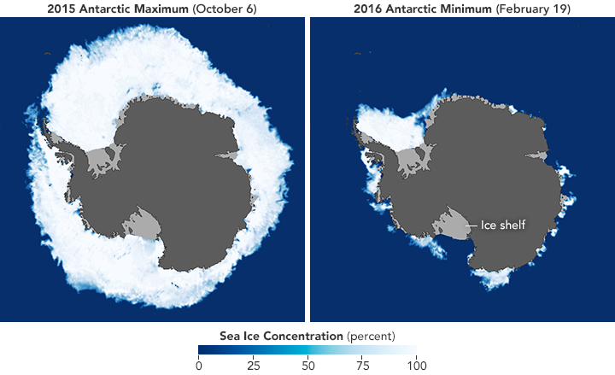
Trends in Arctic and Antarctic sea ice
2016 Arctic sea ice 2016 Antarctic sea ice
seasonal maximum seasonal minimum seasonal maximum seasonal minimum
NASA data

Slide 14
Cooling of Antarctica due to ozone hole
Loss of ozone layer causes some loss of heating
UV
Ozone layer
Absorption of radiation
= heat
10 miles
Terrestrial radiation
Antarctica

Slide 15
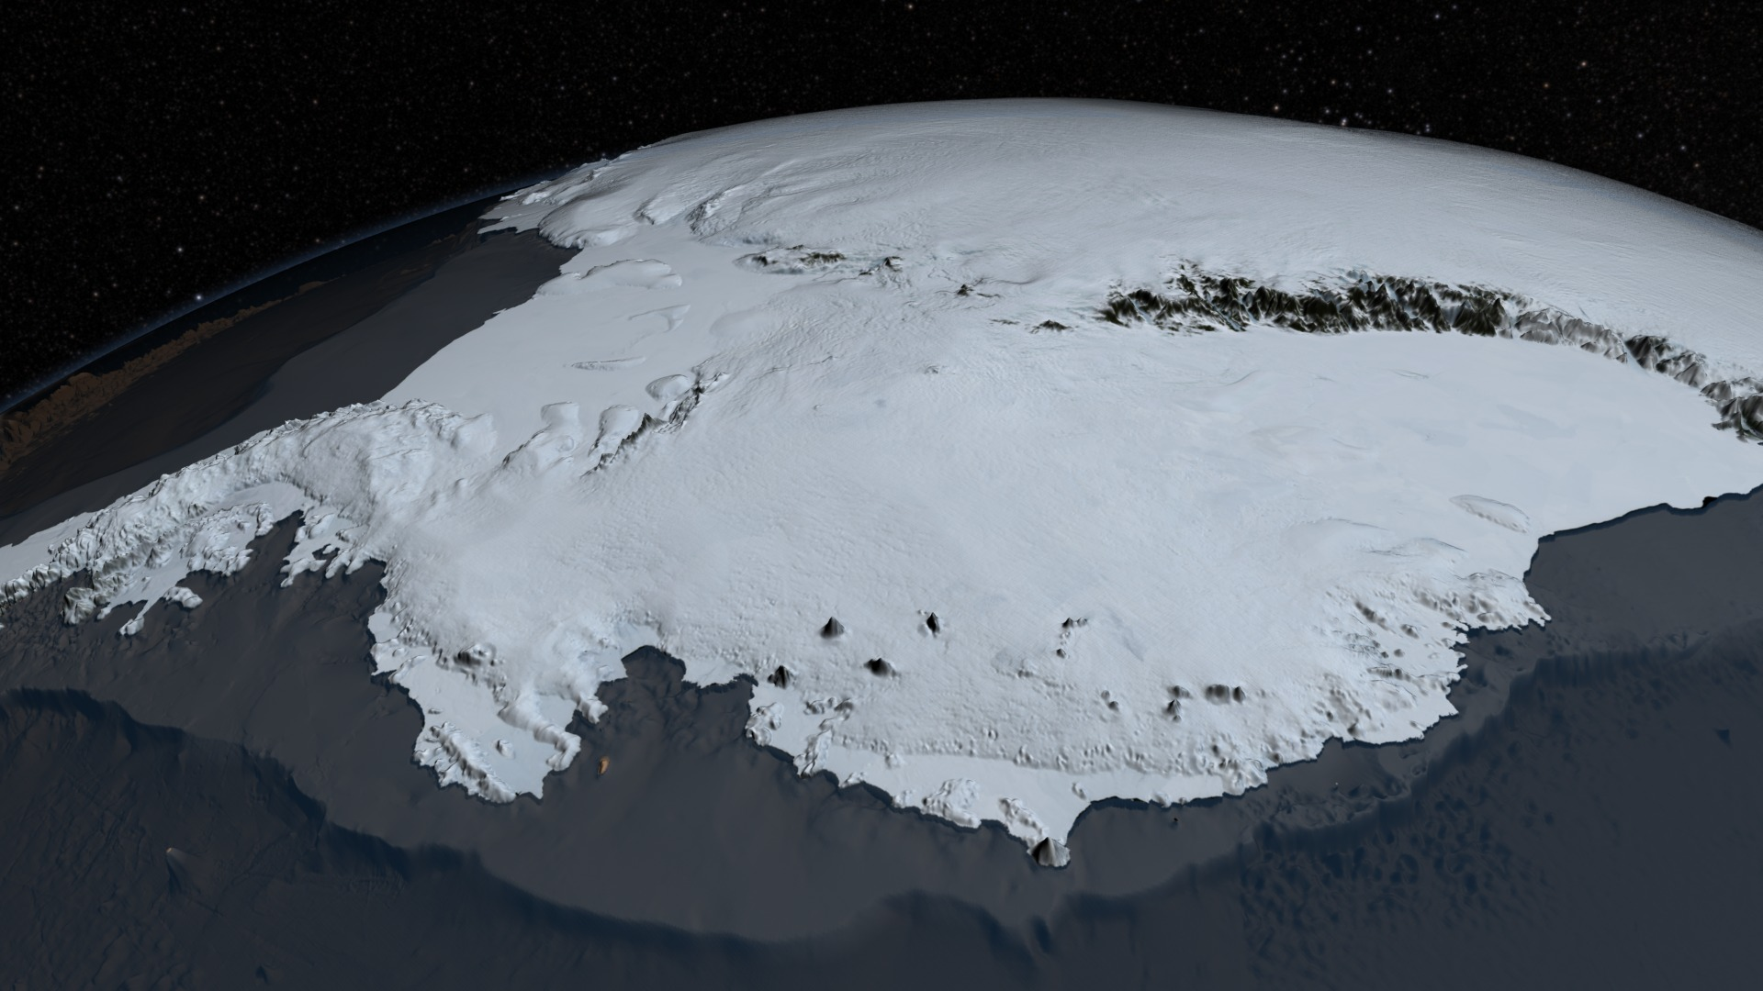
The Antarctic ice sheet: the largest freshwater reserve on Earth
If the Antarctic ice sheet were to melt away sea level would rise by 200 feet
Snowfall over Antarctica transfers 1 inch of ocean to the ice sheet every 5 years

Slide 16
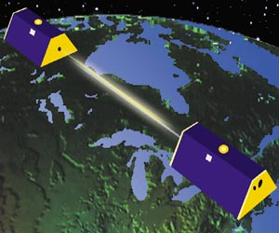
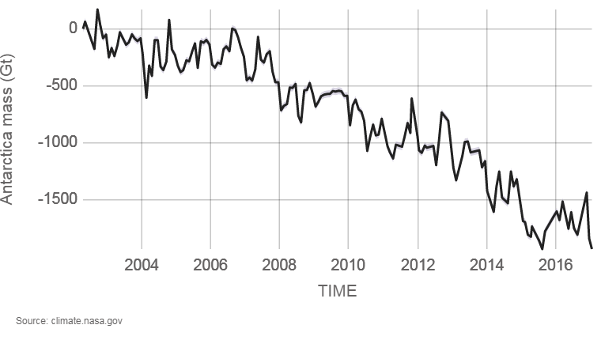
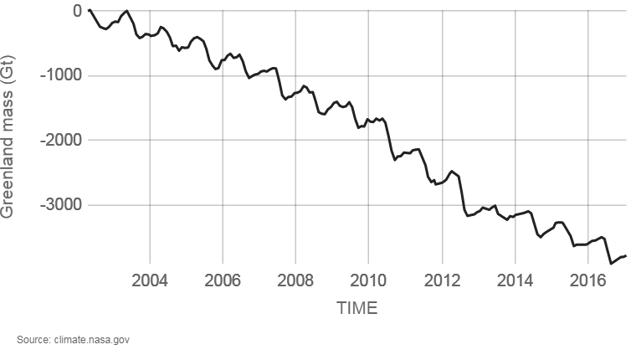
Melting of Antarctic and Greenland ice sheets
Measured by high-resolution gravity data
from NASA GRACE satellite
Total Antarctic ice mass: 30 million Gigatons (Gt) Total Greenland ice mass: 3 million Gt

Slide 17
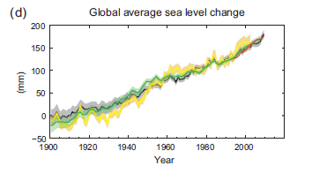
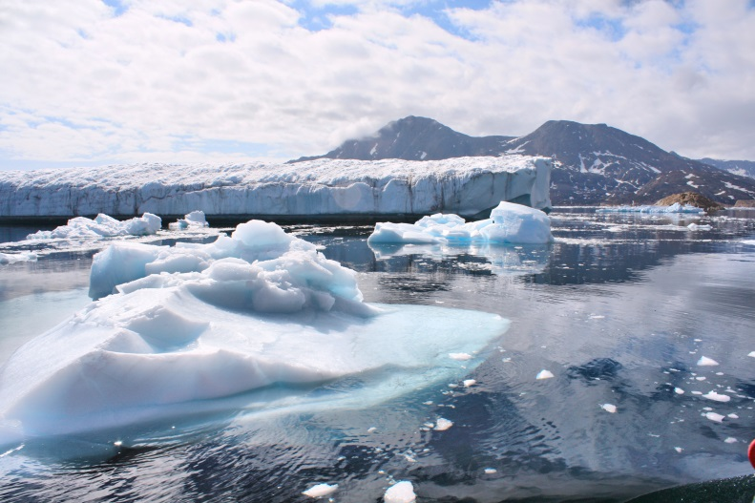
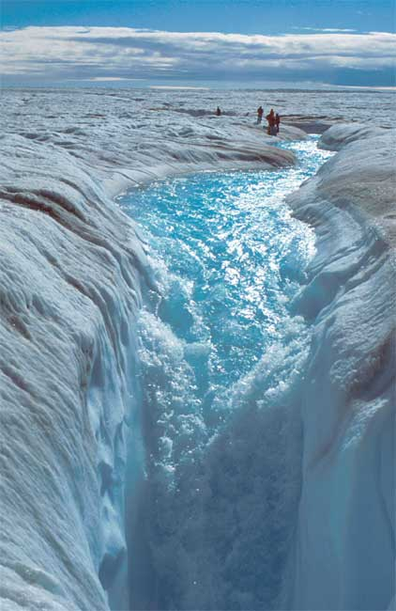
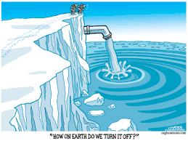
Melting ice and sea level rise
Sea level has risen 7 inches
since 1900
land
storage
Antarctica
thermal
expansion
Greenland
glaciers

Slide 18
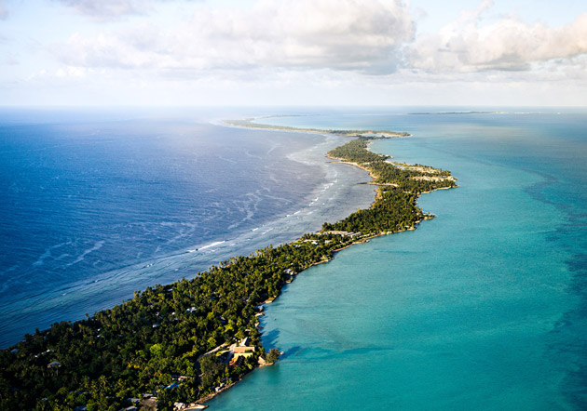
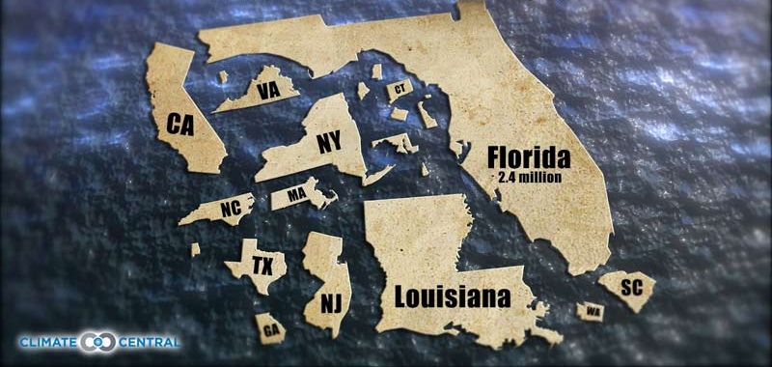
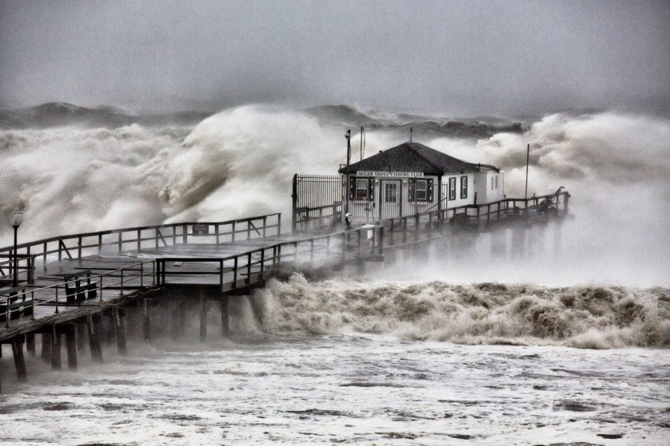
Very obvious impacts of sea-level rise
Islands, low-lying areas become uninhabitable
4.9 million in US live less than 4ft above sea level
Kiribati
Hurricanes, coastal storms cause more damage

Slide 19
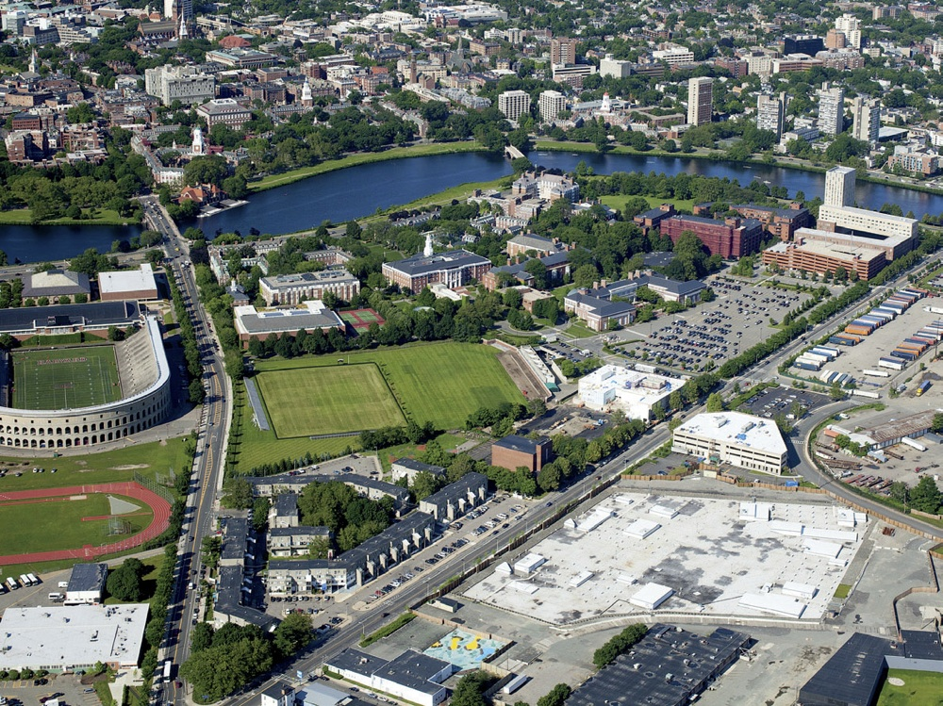
Development of the Harvard Allston campus: consideration of sea-level rise out to 2200

Slide 20
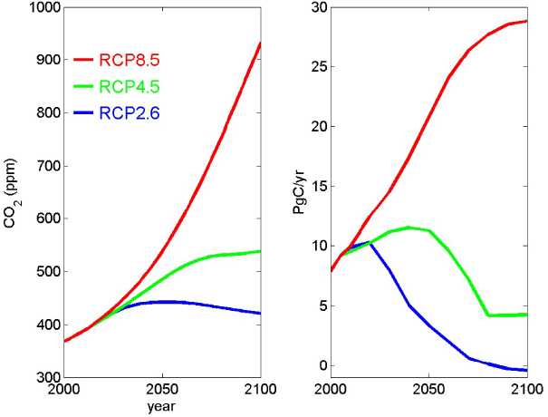
Future projections of CO₂ emissions
IPCC Representative Concentration Pathways (RCP)
CO₂ concentration Emission
business
as usual
today
aggressive
intervention

Slide 21
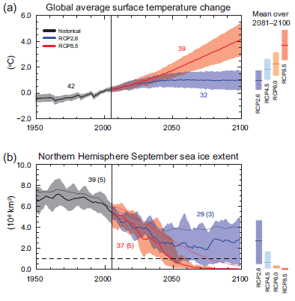
What does this mean for future climate change?
business-as-usual
scenario: 8ºF warming
by 2100
Aggressive intervention: climate stabilization

Slide 22
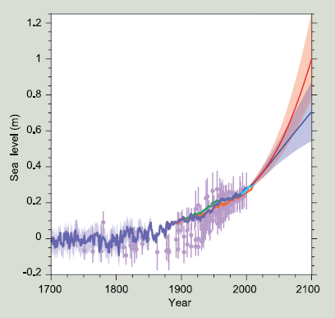
Projections of future sea-level rise
Limiting future rise to 1 foot will require
aggressive intervention

Slide 23
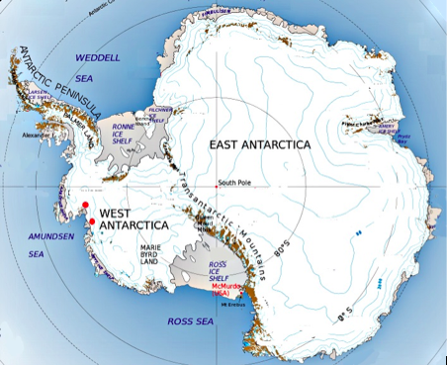
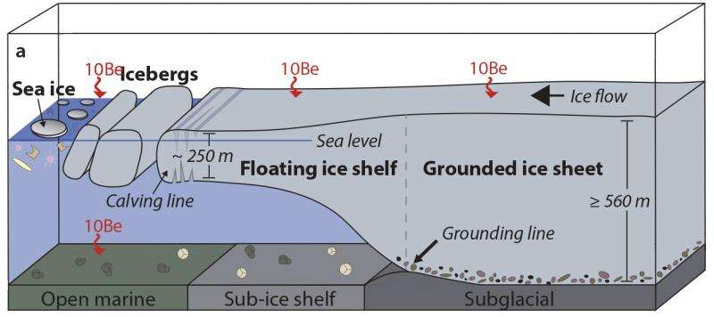
Concern over possible collapse of Western Antarctic Ice Sheet
The Western Antarctic Ice Sheet is being eroded from below by retreat of the grounding line
Total collapse would raise sea levels by 7 m

Slide 24
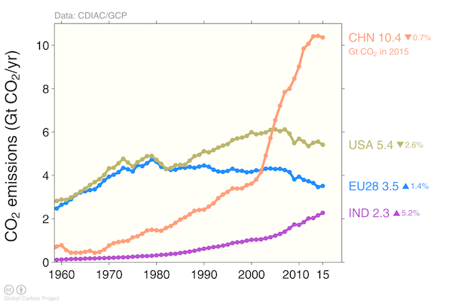
There is hope: CO₂ emissions are flattening out globally,
decreasing in developing countries
China
US
Europe
India

Slide 25
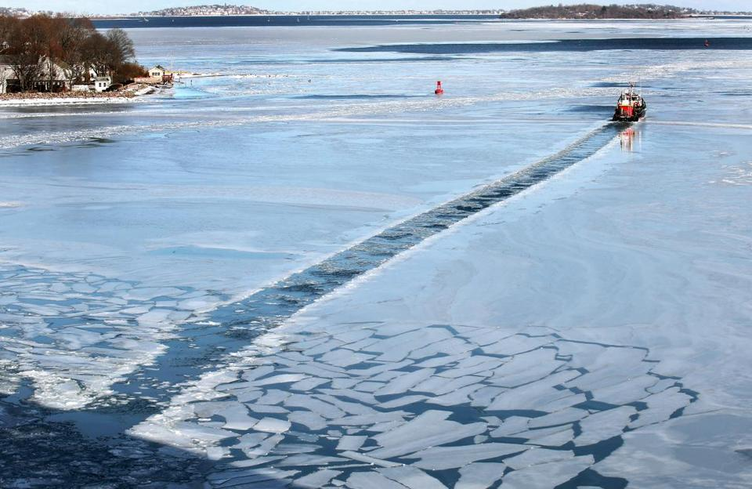
Sea ice in Boston Harbor
Stalled jet stream

Slide 26
Made by: Zorana Vekić

